Slide 1
Updated Music Guidelines

Slide 2
Indoor Singing / Outdoor Singing
INDOOR
OUTDOOR
Unmasked soloists, choirs, congregational singing, and instrumentalists can provide music outside, with 6 feet of physical distance between as many people as can safely maintain physical distance.
Masked soloists, choirs, and congregational singing can provide music inside as part of worship, with 6 feet of physical distance among musicians and others. (This guidance begins on May 23, 2021.)

Slide 3
Masks
While indoors, all those singing congregationally, in a small group, or if more than one other person is present must always wear a high-quality, well-fitting mask. That means a surgical or multilayer cloth mask that fits snugly over both nose and mouth.

Slide 4
Spacing
The distance between outdoor singers (individuals or households) is 6 feet. Singers should not face one another.
Choirs: Spacing options include a grid of 6x6 squares with chairs in the middle of squares to anchor singers. In a semicircle, only the people on the ends may angle their bodies towards the center.
Congregations: The 6-feet separation rule for singing applies to households or individuals. The distance should be measured from the edge of one household to the edge of another.
Conductor/Accompanist should be more than 6 feet away from the front row of singers.

Slide 5
Breaks
A break of 5 minutes will be taken after 15 minutes of singing (or a break of 10 minutes after 30 minutes).
60 minutes is the maximum time for outdoor choir rehearsals.
Time of singing should not be a problem for congregations singing hymns during an outdoor worship service.

Slide 6
Instruments
Handbell choirs may resume with 6 feet between masked members.
Wind or brass instruments are permitted IF
the ensemble is limited to a maximum of 4 musicians spaced 15 feet apart, all of whom have negative COVID tests, and
all instruments have bell covers.

Slide 7
HVAC
For indoor singing and playing wind or brass instruments, the recording space must have moving outdoor air or actively circulating indoor filtered ventilation at a MERV 13 level or higher with room air exchange at least three (3) times per hour.

Slide 8
Remember the Basics for Singing
Sanitize
or
Wash
Hands
Masks
10 Feet

Slide 9
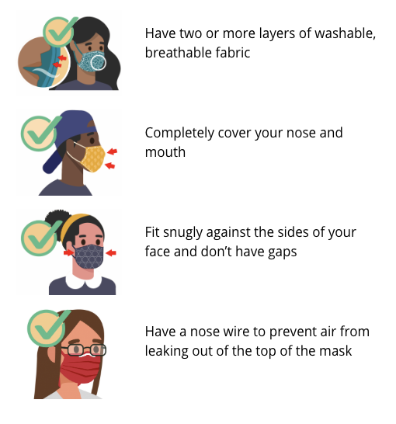
Masks
The CDC recommends layering masks as new variants of the coronavirus are present in our communities to ensure the masked is fitted snugly.
The Diocese strongly encourages but does not require this practice.

