Slide 1
Turning the Corner Again
Stage Two revisited

Slide 2
When to Go Back to Stage 2
Follow the Public Health Indicators
The 14-day rolling average for overall percentage of positive COVID-19 tests for a particular county must be 6.5% or lower.
The 14-day rolling average of number of new cases in a county must be flat or declining.

Slide 3
Keeping Track of Covid Cases https://covid19.ncdhhs.gov/dashboard

Slide 4
Reopening Offices
Church offices reopen at the discretion of local clergy and lay leadership, if there is adequate space for physical distancing and good ventilation (preferably fresh air). Masks are required.

Slide 5
Remember the Basics
Sanitize
or
Wash
Hands
Masks
6 Feet

Slide 6
Indoor Worship / Outdoor Worship
INDOOR
OUTDOOR
6 Feet
25 People or Fewer
Up to 50 People

Slide 7
Virtual worship will still be necessary
6 Feet

Slide 8
Holy Eucharist: Restrictive practices are still in place
Communion is distributed in one kind (host only).
Use of the common cup is suspended.
Only the celebrant may consume consecrated wine.
The host is consumed by worshipers once they have returned to their seats. Feet

Slide 9
Preaching: The preacher MAY preach without a mask IF…
Share the Good News!
But not the virus.
the sermon is prerecorded, or
the sermon is preached at the end of an indoor recording session, once all participants except the masked cameraperson leave the space.
The cameraperson must remain at least 20 feet away from the preacher. The preacher’s mask must be worn before and after the sermon is preached.

Slide 10
Music:
A soloist may be recorded in the church following the same restrictions as the preacher: One other person, either instrumentalist or camera operator, may be present if wearing a mask and standing at least 20 feet away from the soloist.

Slide 11
Music:
Instrumentalists in the livestream are permitted. Wind or brass instruments are permitted IF
the ensemble is limited to a maximum of four (4) musicians spaced 15 feet apart, all of whom have negative COVID tests,
the recording space has moving outdoor air or actively circulating indoor filtered ventilation at a MERV 13 level or higher with room air exchange at least three (3) times per hour,
all players practice strict social distancing and mask use for one week prior to recording
all instruments have bell covers, and
players take a break after 30 minutes to let the room air pass through filtration

Slide 12
Meetings: Vestry, Bible Study, Etc.
INDOOR
6 Feet
15 or fewer people might consider meeting in person, indoors or outside, while wearing masks and maintaining physical distancing, or they may continue to gather online.
&
OUTDOOR

Slide 13
Outdoor and Indoor Pastoral Visits
Pastoral visits by clergy or lay visitors, each party wearing a mask and remaining at a physical distance of at least 6 feet, are permitted.
In-home distribution of communion (bread only) by a member of the clergy or a Lay Eucharistic Visitor (LEV) is also permitted.

Slide 14
Masks
Continue to wear masks in public settings, at events and gatherings, and anywhere you will be around other people, regardless of their vaccination status.

Slide 15
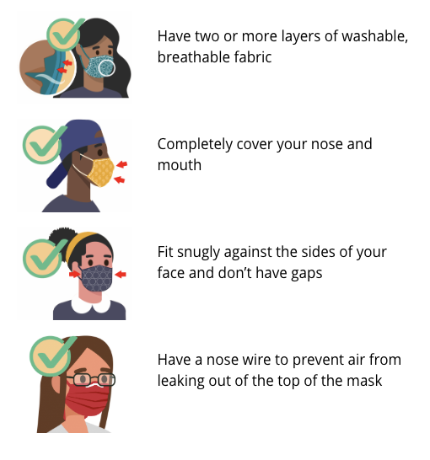
Masks
The CDC recommends layering masks as new variants of the coronavirus are present in our communities to ensure the masked is fitted snugly.
The Diocese strongly encourages but does not require this practice.

Slide 16
Some Tips from the First Round of Stage 2
Post signs of COVID requirements
Stationary alms plate
Have a way for people to sign up to attend worship
Space pews or different pews for different services
Bulletins in pews in advance or print your own at home
Appropriate model for communion
Hand sanitizer available before communion and other times
No physical contact at Sharing of the Peace; perhaps substitute a reverent bow
No sharing vestments
Policy around singing and distance / masks

Slide 17
Review or Update Your Plans for Reopening
What are your plans for
Worship
Facility Use
Meetings
Baptisms
Weddings
Ministry at the Time of Death
Funerals
Outreach or Direct Services
PLANS

Slide 18
Stay Informed
All levels of church leadership need to lead with knowledge and information to help our people cope with the changing nature of the phased community approach to reopening.

